Slide 1
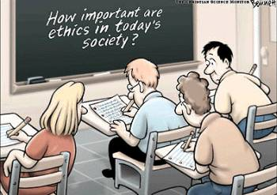
Professional Practice Ethics
2026 Semester 2
Final lecture and Q&A
Dr Mark Howard
mark.howard@unimelb.edu.au
Notes:
Welcome to the final lecture, and well done on making it to the end.
Important that beyond listening to the lectures that you do the exercises I provide and to do the readings. Even if you do not plan to write the ethics essay, as I have mentioned, professional practice ethics is not simply an academic exercise.
Hopefully, you remember from the earlier lectures that our primary focus is applied ethics. We have done some of the normative work, looking at ethics frameworks and the conceptual tools, and then used them to consider real-world situations. And hopefully this will guide you as professional engineers.
We have looked at the critical concept of duty of care and discussed how our code of ethics is an attempt to codify our moral obligations, helping reconcile the competing interests of doing your job to the best technical standards whilst fulfilling your moral obligation to the community.
Importantly we have discussed that we must treat all persons as if they have inherent value, and we must not act purely from self or sectional interests.
And hopefully at the end of this lecture there will be time to ask some questions about the course content, and also the essay. And we may be able to look more closely at some of the activities I have set.

Slide 2

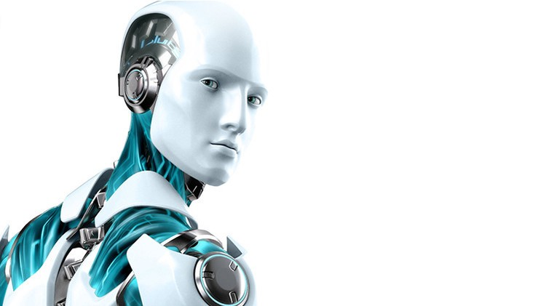
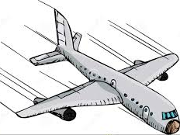
Designing the Future: Automated vehicles, Artificial Intelligence and Robotics

Slide 3
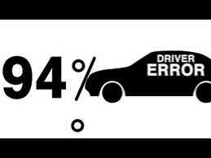
Automated Vehicles
Road traffic accidents (2017)
1.25 million people killed every year in road traffic accidents
The leading cause of death among people aged 15-29 years
Costs governments approximately 3% of GDP
Over 90% of all road traffic accidents are caused by human error and behaviour
  Drink driving, inattention, speeding, drug use…
Autonomous vehicles (the future)
Engineers tell us autonomous vehicles can do better, they will save lives
At some point, they will become safer than human drivers

Slide 4
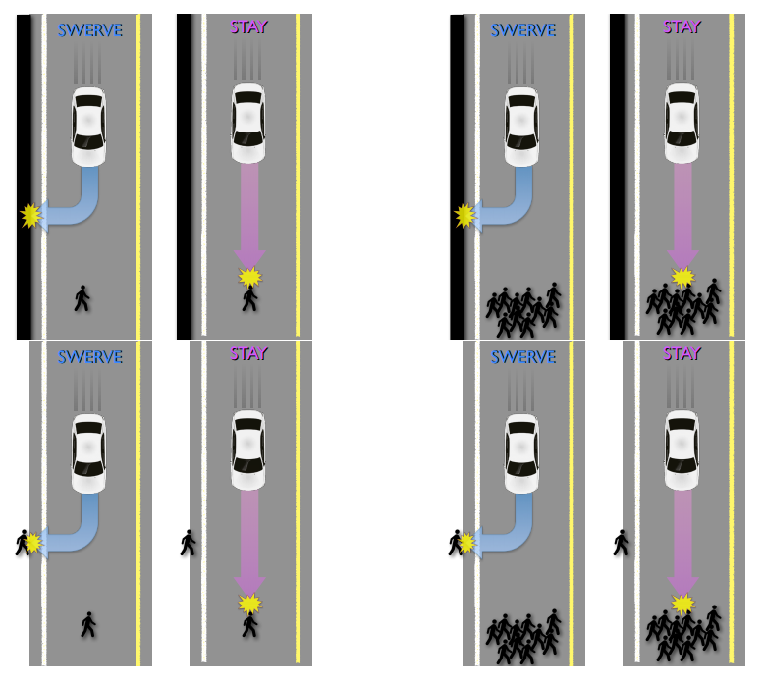
Automated Vehicles
Crash Systems and the Trolley Problem
How do you embed moral principles into a driverless vehicle?
  Are utilitarian crash systems the only option to make the problem tractable?
  This conclusion requires a willingness to trade-off the interests of different individuals of the sort that utilitarianism is notorious for and for which it has been roundly criticised
  Situations of unavoidable harm
  The trolley problem for crash system engineers.

Slide 5

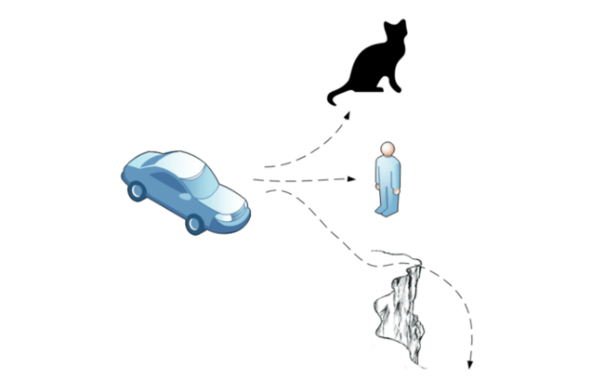
Automated Vehicles
Limit the harm done
  Self-sacrificing crash systems
    We would be trading off their safety for benefits that will accrue to others.
    If adequately informed would we still wish to travel in a driverless vehicle?
    Serious implications of poor sensor design or cost cutting
  Unfair discrimination?
    Helmeted or non-helmeted motorcyclists
    Grandmother or child (see Lin)

Slide 6
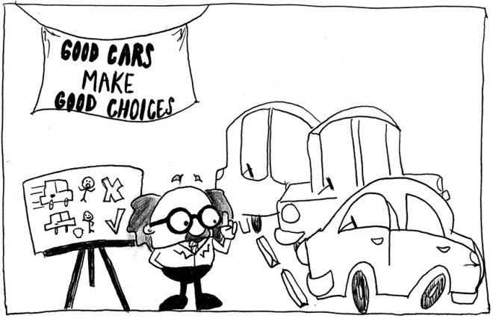
Automated Vehicles
Automated vehicles and “Crash
Systems”
Defining the algorithms that direct DV’s how to behave in crash scenarios is formidable
  Being consistent (non-arbitrary)
  Being acceptable to the public (properly compelling)
  Remaining marketable

Slide 7
Boeing Max 737
Commercial interest and good design
  Boeing needed a fuel efficient and cost-effective alternative to maintain market share.
  Limited design changes to avoid upgrades to assembly lines
  New engine location risked causing the plane to tilt upwards and stall the plane. This risk was offset by installing the Maneuvering Characteristics Augmentation System (MCAS). However, if the angle-of-attack sensor was faulty, the MCAS would cause the plane to nosedive.
  Outsourced software design to save money
  “workarounds” to avoid delaying flight testing
  Violated the principle of redundancy in design
  The Ford Pinto with wings?? Or a low flying Challenger??

Slide 8
Now it is your turn
Activity: Thinking about your engineering project.
Thinking about yourself as an engineer, address the following:
  What purpose, principles and value do you bring to your role as an engineer?
b. Reflect on your project from an ethical perspective and consider:
  What you are trying to do (what is your purpose)?
  Why are you doing it (what are your values and goals)?
  How you intend to do it (what means will you use to achieve your goals and what principles will constrain this approach)?
  What you will achieve (what are the foreseeable ends, intended and unintended)?

Slide 9
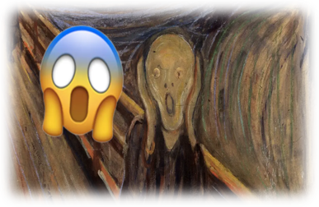
Assignment 2
Details
Essay/report (week 11) and short oral presentation (week 12)
Project management and Ethics
Project based
Total marks available: 15
Late Penalty: -10% per day

Slide 10

Assignment 2
Written statement
Length: maximum 850 words
In your statement, at a minimum, complete the following tasks.
1. Plain language description of your project
2. Nominate 3 key stakeholder groups
3. Purpose statement
4. List 3 ethical values and 3 ethical principles
5. Goals, means and ends
6. Relevant tenets of the Consult Australia and/or Engineers Australia
Notes:
Moral and non-moral factors:
Moral Factors are factors that make the right kind of "ought claims" (for example, in the lectures I discussed how legal ought claims differed to ethical ought claims, and both differed to prudential (self-interest) ought claims. Moral considerations have a universal nature, that is, they extend beyond sectional interests and our own values and promote the importance of the wellbeing of others. Moral factors in the Ford case may include decisions about safety and vehicle owners/occupants were informed about the changes to car (both should have been informed by the universal claim of ethics, but ultimately they were diminished by sectional interests). Non-moral factors include those that had commercial/sectional/personal interest at the core (e.g. design decisions made based on cost/time). Cost and time in this instance were non-moral factors that should not have determined the final outcome.
Simply meeting design standards is not an adequate defense if you are aware of foreseeable risk. As discussed in the lectures. Meeting the technical requirements of a design brief is not the same as fulfilling your duty of care.
The occupants of the vehicles did not have enough information to make an informed decision about the safety of their transport. How do you think the drivers and passengers (and public) would have responded if they were given all the appropriate information?
The case studies we looked at in the lectures all raised issues about our ethical responsibilities and spotlighted the consequences that may arise when we mistakenly believe our professional duty absolves us of our ethical responsibilities. Or when we advance prudential reasons ahead of our moral obligations. In the Pinto case we see the cost of prioritising design goals (or means) ahead of ethical considerations.

Slide 11
Assignment 2
Oral Presentation
1. Presentation of ethical review of your project
An opportunity to provide further information about the ethical aspects of your project, providing additional information and demonstrating your depth of knowledge regarding professional practice ethics
2. Question and answer
Examples of the questions.
why you are confident you could meet your duty of care
what steps you could take to minimize any harm to stakeholders who may not directly benefit from the project?
Notes:
Moral and non-moral factors:
Moral Factors are factors that make the right kind of "ought claims" (for example, in the lectures I discussed how legal ought claims differed to ethical ought claims, and both differed to prudential (self-interest) ought claims. Moral considerations have a universal nature, that is, they extend beyond sectional interests and our own values and promote the importance of the wellbeing of others. Moral factors in the Ford case may include decisions about safety and vehicle owners/occupants were informed about the changes to car (both should have been informed by the universal claim of ethics, but ultimately they were diminished by sectional interests). Non-moral factors include those that had commercial/sectional/personal interest at the core (e.g. design decisions made based on cost/time). Cost and time in this instance were non-moral factors that should not have determined the final outcome.
Simply meeting design standards is not an adequate defense if you are aware of foreseeable risk. As discussed in the lectures. Meeting the technical requirements of a design brief is not the same as fulfilling your duty of care.
The occupants of the vehicles did not have enough information to make an informed decision about the safety of their transport. How do you think the drivers and passengers (and public) would have responded if they were given all the appropriate information?
The case studies we looked at in the lectures all raised issues about our ethical responsibilities and spotlighted the consequences that may arise when we mistakenly believe our professional duty absolves us of our ethical responsibilities. Or when we advance prudential reasons ahead of our moral obligations. In the Pinto case we see the cost of prioritising design goals (or means) ahead of ethical considerations.

Slide 12
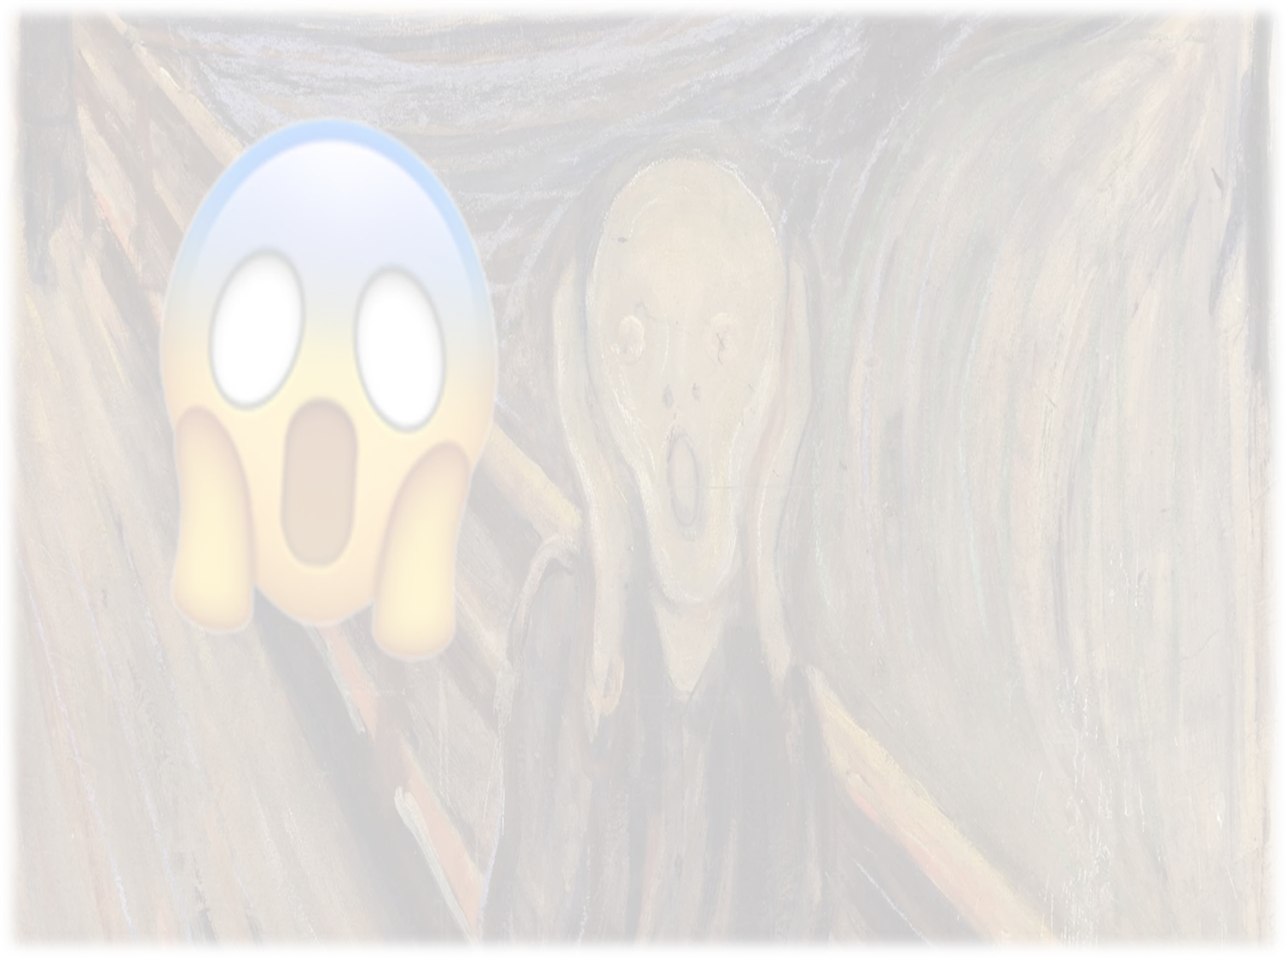
Essays
Advice
A list of potential readings and resources will be available on Canvas, but please draw on other relevant sources.
Stick to reputable sources (not Wikipedia). Try google scholar and the library search
As you research, take notes
  Esp. page numbers for quotes and claims you paraphrase
Referencing is a requirement of this assignment (including AI)
Read the question carefully:
  Identify the key terms
  Ask yourself: Why is this question important?
  How does my answer demonstrate my knowledge?

Slide 13
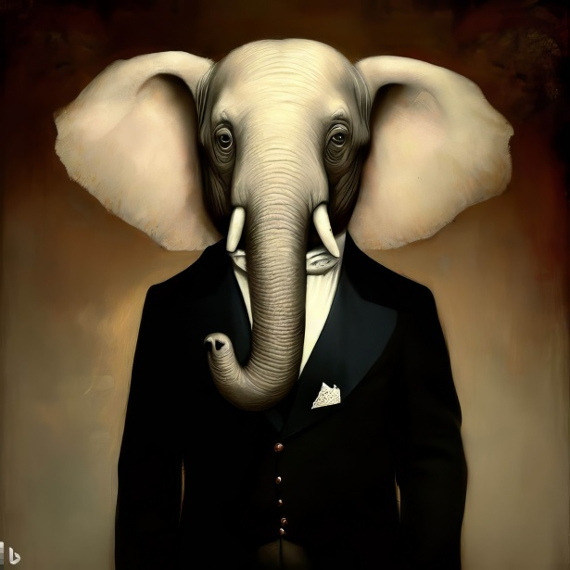
The AI Elephant in the room

Slide 14
What we will explore
The aim of the ethics classes is to make ethics a virtue so that you understand how to be a responsible and ethical engineer and how to apply ethical principles to your work.
Ethics is complex, multifaceted and deeply grounded in philosophy.
It involves ethical decision making and moral responsibility
Our intention is to make these aspects concrete, practical and relevant

Slide 15

We want you to:
Understand
understand ethics and professionalism
Apply
apply ethical thinking to your professional tasks
Identify
identify the ethical dimensions of your work
Think
think deeply about becoming an ethical, reflexive professional
Find out
find out more about ethical guidelines, ethical codes, processes and heuristics to use in your professional lives
Notes:
Ethics is constitutive of Professionalism
Ethical impact assessment, purpose statements etcetera
Ethical dimensions? Make right kind of ought claims; are universal…

Slide 16

What you should understand
Understand the connection between professionalism and moral responsibility.
Differentiate between various ethical frameworks and identify which is best suited to you.
Identify different decision-making frameworks and ethical design approaches that are applicable to, and may be utilised in, your specific field.
Understand how a professional code of ethics represents various ethical frameworks and codifies your moral obligation as a professional.

Slide 17
Ethical Impact Threshold Assessment
Because of the serious moral challenges that are raised by emerging technologies … it is important for us to have an understanding, as early as possible in the innovation cycle, an understanding of the ethical issues, dilemmas and opportunities engendered by emerging technologies.
https://www.sienna-project.eu/robotics/

Slide 18
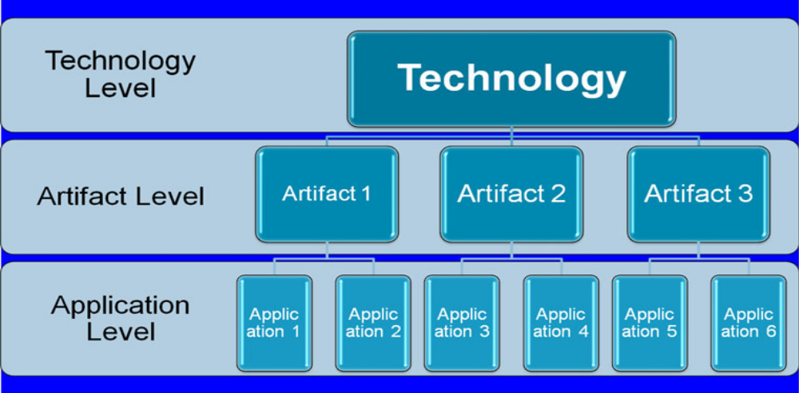
Technology Ethics
Technology: Defined, independently of any artifacts or applications.
Artifact: Usable products (physical and procedural) of a technology
Application: How the artifact is used by various users in particular contexts and domains
(Source: Brey 2012)

Slide 19

Societal responsibilities as a challenge
The role of the professions and its importance in helping make society/communities function better.
The concept of the ‘social contract’ – rewards of status/privilege/money/etc in return for supporting societal needs.
Notes:
Explain the idea of the social contract for professionals and researchers.
Your loyalty is to your community, not your employer.

Slide 20

Ethics
Ethics is about how we ought to behave. And why.
Ethics is a part of everyday life
  Ethics applies to all people, in all places, at all the time (there’s no such thing as a ‘ethics-free zone’)
Ethical insights can range from the trivial to the profound
  Sometimes morality is straightforward, other times it can be very complicated

Slide 21

The Language of Ethics
Different kinds of “Ought” claims
Morality vs Self-interest
Even though ethical behaviour is often in someone’s self-interest, ethical behaviour is not the same as self-interest.
Morality vs Legality
Do not conflate morality with legality:
The law sets a minimum standard
Ethics demands the best possible behaviour
Notes:
Moral philosophy is couched in “ought” claims: That is, “you should do x”
In ethics, it is important to distinguish MORAL OUGHT CLAIMS, from other kinds of ought claims.
One way to do this is to contrast moral ought-claims with different kinds of ought-claims:
Two we will quickly look at are self-interest, and legal ought claims. These typically make prescriptive claims, but are not morally prescriptive.
First, self-interest is about what is personally beneficial, but not morally always the right thing to do.
Second, while the law often captures moral standards, legal & moral ought-claims aren’t always the same. Sometimes the morally right thing to do is to break the law! (unjust laws)
The classic example is slavery, which historically was legally allowed, but not ethically permissible.
If you are asked to justify an action from an ethical perspective an appeal to self interest or the legality of the activity will not be adequate.

Slide 22
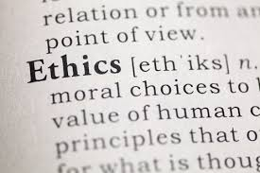
Ethics? What Ethics?
Ethics is about how we ought to behave. And why.
Most of us rely on our “moral intuitions”, but how do we decide when it is not intuitively obvious what to do? How do you defend your position when others disagree?
We want a guide for our actions, we want our actions to be right or wrong for:
non-arbitrary
and properly compelling reasons
Ethics is the part of practical reasoning concerned with good, bad, right, wrong, duties, rights, etcetera.
Ethical theories add consistency and clarity to our moral reasoning.
Ethics Matters. Dan Halliday, University of Melbourne
http://ethicsmatterstvseries.com/tv-series
Notes:
So, what is ethics really about? What does it mean to conduct yourself morally?
Who here considers themselves to be a moral person?
Why? What does it mean to be moral? How do you know?
Most of us rely on our moral intuitions… Ethical theories help us overcome the shortcomings of “intuition”.
Ethics is the conceptual toolkit we use when trying to figure out what we ought (morally speaking ) to do in any given case.
It is the part of practical reasoning concerned with good, bad, right, wrong, duties, rights, etcetera.
So, ethics is about how we ought to behave. And why. The WHY part is crucial here:
We want a guide for our actions based on the best possible reasons, we want our actions to be right or wrong for
non-arbitrary
and properly compelling reasons
Ethical theories add consistency and clarity to our moral reasoning.
Contemplating our ethical theories should "educate our sensibilities" about possible attitudes and practical behaviours.
We need to make explicit our assumptions and fundamental ethical principles. Transparency in our decision-making process is crucial to allow others (and ourselves) to make critical assessments.
Watch this series by Dan Halliday, and ethicist and friend from UoM.

Slide 23



Overview of ethical theories
Agent
Virtue Ethics
Is the agent ‘good’?
Does the agent do what makes them a ‘good’ person?
Don’t judge the actions; judge the agent
Act
Deontological Ethics
We should not focus on the consequences. Is the action a morally good one?
Some actions are absolutely right or wrong
Outcomes
Consequential Ethics
The end justifies the means
All’s well that ends well
If the consequences are good then it justifies the action taken
https://slideplayer.com/slide/5960678/
Notes:
Our focus - whether on the agent, the act or the outcomes, roughly aligns with ethical frameworks, which we will talk more about shortly.

Slide 24
Summing up: Ethics 101
Virtue Ethics: Moral character: Behave in a manner that exhibits certain characteristics, such as generosity, compassion, etc.
  What kind of person would do this?
Deontology: Rule based ethics: certain acts are intrinsically right or wrong.
  E.g. We must never kill another person, regardless of the consequences
Consequentialism: Ethical calculations are focused on the outcome.
  Act to bring about the best consequences, to maximise happiness. The end justifies the means.
Notes:
As mentioned in an earlier slide, these ethical theories are traditionally distinct in theoretical terms, but as we’ll see, in practice we often base our decisions on a combination of factors.

Slide 25
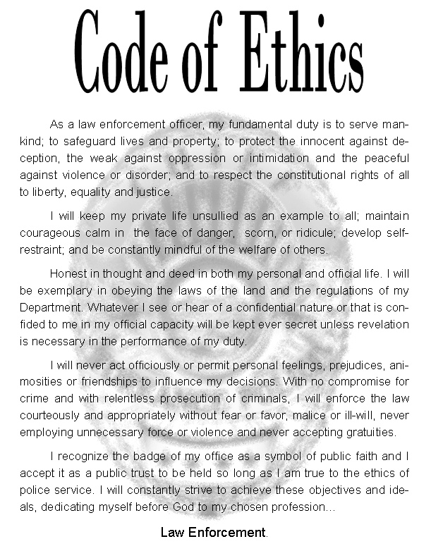
Doing ethics
  Normative principles and applied ethics
Professional code of ethics: An attempt to codify our moral obligations (normative), to formalise our ethical responsibilities in professional environments.
Duty of care: take care not to act in ways which any reasonable person could foresee might harm others. We must not act in ways that could reasonably be foreseen to create risks of future harm to others, and indeed to eliminate those risks if we have created them.
Principlism: applied ethics approach based upon the application of certain ethical (normative) principles (not values).
  E.g. The foundation of medical ethics: Autonomy, Beneficence, Non-maleficence, Justice.
Notes:
A few things you should be aware of:
Professional code of ethics: An attempt to codify our moral obligations (normative), to formalise our ethical responsibilities in professional environments. They infer duty and obligation.
The notion of a duty of care is central to many codes of professional ethics.
The dominant approach to professional ethics is Principlism. Principles derived from normative theories but not aligned with any single approach. Typically pluralistic, and this is important for institutional decision making and community adoption.

Slide 26
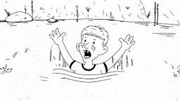
The Drowning Child
Testing our moral intuitions: Part 1
On the way to your University ethics class you notice a child apparently drowning in a pond. Efforts to save the child will result in ruining your new clothes and fancy shoes. It will also mean you miss class. Do you have an obligation to rescue them?
What moral obligations do we have to others?
What is most important to our assessment of the ethical situation:
the agent?
the act?
the outcome?
Is there an “expanding circle”
of moral obligation?

Slide 27
The Trolley Problem
What’s the right thing to do here?
A Utilitarian response
Pull the lever!! Better to sacrifice the 1 so that the 5 can live
A Deontological response
Don’t do it!! It’s categorically wrong to ever treat people merely as means and not ends in themselves
Virtue Ethics response
Do whatever the virtuous person would do!

Slide 28
The Trolley Problem
What’s the right thing to do here?
These ethical theories are traditionally distinct in theoretical terms, but as we’ll see, in practice we often base our decisions on a combination of factors
Crucially, as ethical theories, they guide our actions and provide explanation for right action
They aim to:
  be non-arbitrary,
  be properly compelling,
  add consistency and clarity to our moral reasoning

Slide 29
Summing up: Ethics 101
Ethics is concerned with what ought to happen, and why
Normative ethics: Attempts to provide a general theory that tells us how we ought to live.
Applied ethics: Applying normative ethical theories to specific issues (practical ethics).
In normative ethics there are (broadly speaking) 3 morally interesting factors:
  The agent (approx. Virtue ethics)
  The act itself (approx. Deontology)
  The consequences (approx. Utilitarianism/Consequentialism)

Slide 30
Ethics in Practice
The Case of Willy Just
Can you conceive of an ethical defence that could be offered on behalf of Willy Just?
Could his conduct be morally justified by any of the ethical frameworks we employed in the trolley car cases?
  Virtue Ethics?
  Deontology?
  Utilitarianism?

Slide 31
Ethics in Practice
The Ford Pinto
Can you conceive of an ethical defence that could be offered on behalf of the Ford engineers?
What could the Ford engineers have done, when management refused to improve the safety of the Pinto?
What were the moral responsibilities of the engineers? What was their duty of care?

Slide 32
Ethics in Practice
Willy Just
Professional duties and social justice (code of ethics)
  Prudence (self-interest) and morality
  Imperceptible difference
  Vicarious liability
  Moral tragedy
  Unjust harm
Ford Pinto
Ethical design
  Safe, or safe enough? Unjust harm?
Conflict between commercial and moral imperatives (code of ethics)
  Professional and personal duties
  Duty of care
Space Shuttle Challenger
Design limitations
Whistleblowing (code of ethics)
Notes:
Reference slide.
With Willy Just we contrasted professional duties with social justice and considered how a code of ethics might bridge the gap.
We considered multiple ways to justify the behaviour but we could not produce an ethical defense.
Then we contemplated the Pinto case and contrasted commercial and moral imperatives. We spoke about the risk utility test and compared technical standards with moral standards.
Consider the Ford engineers
Given the sort of things they were complicit in – the rushed production schedule, the compromising of safety for the sake of other product objectives, etc. – it seems hard to resist the thought that they failed to live up to their duty of care.
A tougher situation for the Shuttle engineers, but surely at a minimum the astronauts deserved to know the issues with he shuttle so they could make an informed decision.
And perhaps if the engineers at Boeing had done a professional ethics course and learned about the Pinto and Shuttle, we would not have had the Max 737 disaster.

Slide 33
Ethics in Practice
Questions for all of us.
When there are safety concerns, what is an engineer’s moral responsibility?
How are we to weigh moral and prudential reasons when they are in conflict?
How are we to resolve conflicts between personal and professional ethics? And, between sectional interests and public interests?
Is ethics endlessly demanding?

Slide 34
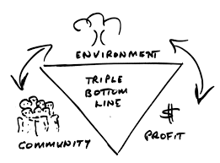
Ethics in Practice
Whistleblowing
Someone who reveals wrongdoing within an organisation to the public or to those in positions of authority
Should managers expect their engineers to be loyal?
  No: Not right kind of relationship for loyalty to exist.
Consult Australia
Members shall at all times place their responsibility for the welfare, health and safety of the community before their responsibility to sectional or private interests, or to other members
Members shall not assist, induce or be involved in a breach of these Tenets and shall support those who seek to uphold them
Engineers Australia
4.2 Practise engineering to foster the health, safety and wellbeing of the community and the environment
Notes:
Whistle blowing (read slide)
We do not need to put the interests of our employer ahead of the well being of our community and the public good. This is made explicit in our code of ethics, which attempt to codify our duty of care and moral obligations. They bridge the gap between our moral obligations and non-moral job specifications.
Looking at some relevant tenets of engineering codes we note here that tenet 1 of Consult Australia and 4.2 of Engineers Australia most closely correlates to the central ethical and legal notion of an engineer’s ‘Duty of Care’.
The duty of care requires that individual persons should take care not to act in ways which any reasonable person could foresee might harm others. Do not use a legal definition of this concept when discussing ethics.
And tenet 9 hints at our responsibilities around whistleblowing and ethical design and in the case studies we considered it suggests the engineers should have refused the assigned work and, possibly, blown the whistle.

Slide 35
Responsibility
Positive responsibility acknowledges there is a moral dimension to engineering and indicates a more professional approach.
This requires acknowledging our (positive) responsibility where we consider how our actions impact others. This requires us to fulfill 4 conditions:
1) Do we understand the potential consequences of our actions?
2) Do we know (can we reasonably predict) what will be the result of our actions (foreseeable, intended and unintended)?
3) Are we acting voluntarily?
4) Will our actions influence outcomes?
Notes:
A key concept associated with professional ethics is responsibility. And I am trying to shift your thinking away from the negative idea of responsibility as liability toward positive responsibility where we consider how our actions impact others. This requires us to fulfill 4 conditions:

Slide 36
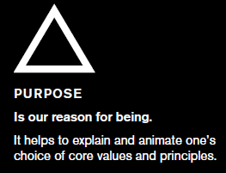
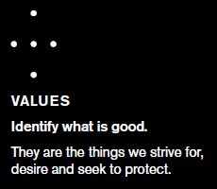
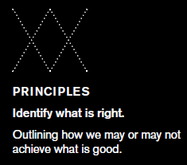
Ethical Framework
“An ethical framework allows us to pursue excellence. By basing our thoughts, decisions and actions in a clear statement of why we’re here, what we stand for and where we draw a line in the sand, we go far beyond a ‘do no harm’ approach to ethics. Instead, we’re able to imagine the best version of something – in this case, the best kind of technology.” (Beard and Longstaff p. 40)
Notes:
See this reading.
An ethical design is the best version of something.

Slide 37
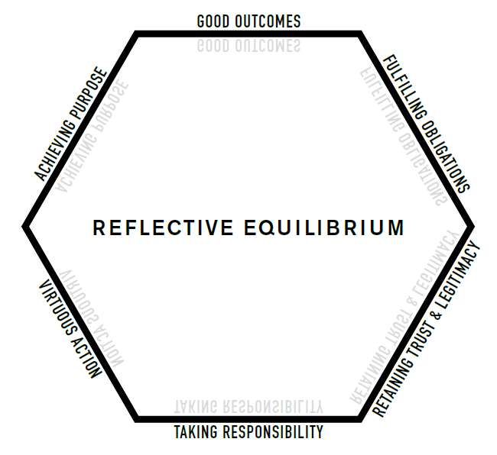
Professionalism
Beard & Longstaff, 2018

Slide 38
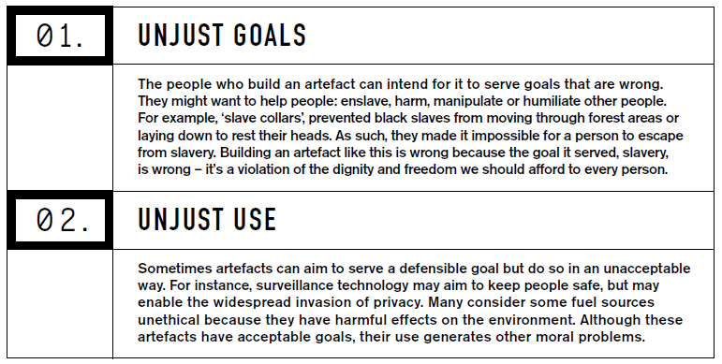
Ethical by Design
  “FIRST, the fact someone has to make a technological artefact means they bear initial ethical responsibility for those artefacts – what they do and how they do it.
  SECOND, we use artefacts to engage with the world. Understanding this means part of the ethics of technological artefacts concerns how they engage with the world and what effects they have.” (Beard and Longstaff p. 25)
  “Artefacts that serve just goals through acceptable means are ethical pieces of technology.”
Notes:
Read Slide
Only technologies that serve just goals through acceptable means are ethical.
Broadly speaking, there are 3 key things to consider in ethical design.
The goals, Means, and ends.

Slide 39
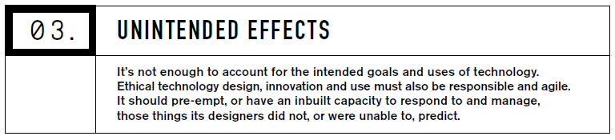

Ethical by Design
  The failure to foresee alternate uses of an artefact – both for good and for ill
  Uncertainty around the effects of new technologies or new uses for existing technologies.” (Beard and Longstaff p. 25)
Goals
Means
Ends
Notes:
It is not enough to consider the intended effects; we must also be responsible for other foreseeable impacts.

Slide 40
Codes of Ethics
Consult Australia
Members shall at all times place their responsibility for the welfare, health and safety of the community before their responsibility to sectional or private interests, or to other members;
Members shall act with honour, integrity and dignity in order to merit the trust of the community;
Members shall act only in areas of their competence and shall practice in a careful and diligent manner;
Members shall act with honesty, good faith and without discrimination towards all in the community, including clients, employers and colleagues;
Members shall apply their skill and knowledge in the interest of their employer or client for whom they shall act with integrity, without compromising any other obligation to these Tenets;
Members shall take all reasonable steps to inform themselves, their clients and employers and the community of the social and environmental consequences of the actions and projects in which they are involved;
Members shall express opinions, make statements or give evidence with fairness and honesty and only on the basis of adequate knowledge;
Members shall continue to develop relevant knowledge, skill and expertise throughout their careers and shall actively assist and encourage those under their direction to do likewise; and
Members shall not assist, induce or be involved in a breach of these Tenets and shall support those who seek to uphold them.

Slide 41
Codes of Ethics
Engineers Australia
1.1 Act on the basis of a well-informed conscience
(a) be discerning and do what you think is right
(b) act impartially and objectively
4.1 Engage responsibly with the community and other stakeholders
(a) be sensitive to public concerns
(b) inform employers or clients of the likely consequences of proposed activities on the community and the environment
(c) promote the involvement of all stakeholders and the community in decisions and processes that may impact upon them and the environment
4.2 Practise engineering to foster the health, safety and wellbeing of the community and the environment
(a) incorporate social, cultural, health, safety, environmental and economic considerations into the engineering task
4.3 Balance the needs of the present with the needs of future generations
(a) in identifying sustainable outcomes consider all options in terms of their economic, environmental and social consequences
(b) aim to deliver outcomes that do not compromise the ability of future life to enjoy the same or better environment, health, wellbeing and safety as currently enjoyed.

Slide 42
Automated Vehicles
Road traffic accidents (2017)
1.25 million people killed every year in road traffic accidents
The leading cause of death among people aged 15-29 years
Costs governments approximately 3% of GDP
Over 90% of all road traffic accidents are caused by human error and behaviour
  Drink driving, inattention, speeding, drug use…
Autonomous vehicles (the future)
Engineers tell us autonomous vehicles can do better, they will save lives
At some point, they will become safer than human drivers

Slide 43
Boeing Max 737
Commercial interest and good design
  Boeing needed a fuel efficient and cost-effective alternative to maintain market share.
  Limited design changes to avoid upgrades to assembly lines
  New engine location risked causing the plane to tilt upwards and stall the plane. This risk was offset by installing the Maneuvering Characteristics Augmentation System (MCAS). However, if the angle-of-attack sensor was faulty, the MCAS would cause the plane to nosedive.
  Outsourced software design to save money
  “workarounds” to avoid delaying flight testing
  Violated the principle of redundancy in design
  The Ford Pinto with wings?? Or a low flying Challenger??

